Slide 1

The biology of…
& Happiness
Manas K Mandal

Slide 2

Belief: A state in which someone holds a premise to be true
Is belief is a simple thinking error?
Can scientific exactitude dissuade believers?
Do unhappy people become more religious?
Is belief a coping mechanism?
Does materialism suppress spiritualism?
What causes developing countries to be more religious but less happy?

Slide 3
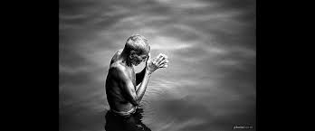
Belief: A state in which someone holds a premise to be true
How far faith & health related?
Does spirituality predict better disease control?
In there a biological mechanism that regulate belief?
Is belief an alternative to medicine?
Can prayer heal our pain or bring us peace?
Is fasting a wellness protocol or traditional ritual?
Does long-term meditation change our brain?

Slide 4
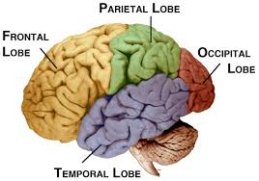
Parietal lobe is pivotal in prayer or in meditation

Slide 5
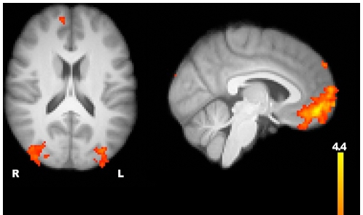
Belief: The brain centers
Greater signal for belief compared with disbelief appeared in ventromedial prefrontal cortex, lateral occipital cortex, & superior frontal gyrus
Harris et al. (2009)

Slide 6
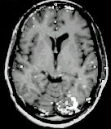
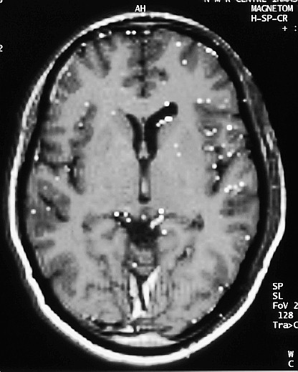
fMRI during Meditation
> 17 Years
During Meditation During Non-meditation
Khushu et al., 2004
Khushu et al. 2007

Slide 7
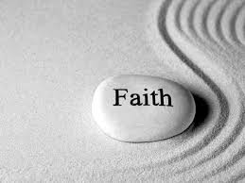
Faith & longevity have a relation
2-3 years of additional life with religious faith
The brain is in a different state during short-term
religious fast
J. Kluger, 2009: The biology of belief TIME

Slide 8
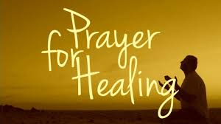
Scientific exactitude fails to explain the role of prayer
HIV patients who pray have higher immunity cells
People who believe in loving God fare better after an illness
than people who believe in punitive God
J. Kluger, 2009: The biology of belief TIME

Slide 9
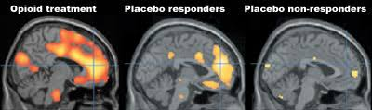
Placebo & Nocebo effects can be verified objectively
Believing in a cure leads to real bodily changes
Pain reducing chemicals are released after a placebo is given
J. Kluger, 2009: The biology of belief TIME

Slide 10
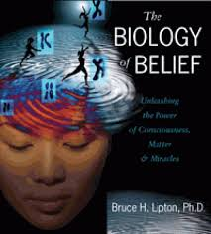
Biology of Belief: Bruce Lipton, 2014
The common idea is that gene determines our physical & mental characteristics
A person’s perception, not genetic programming determines our behavior
Our beliefs select our genes, that determines our behavior

Slide 11
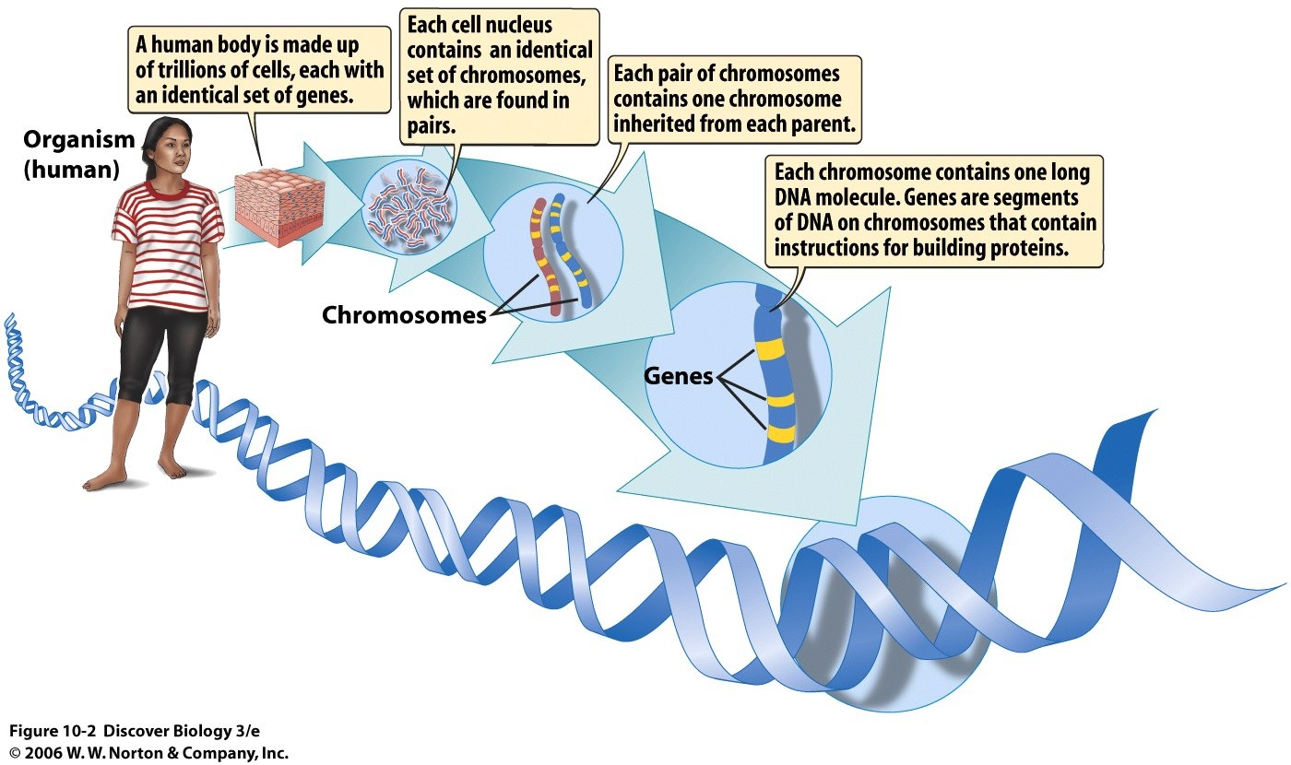
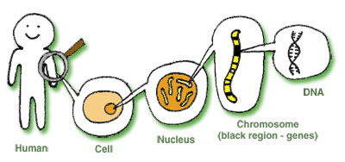

Slide 12
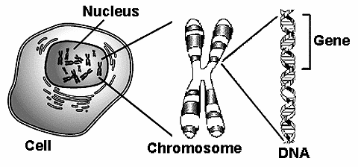
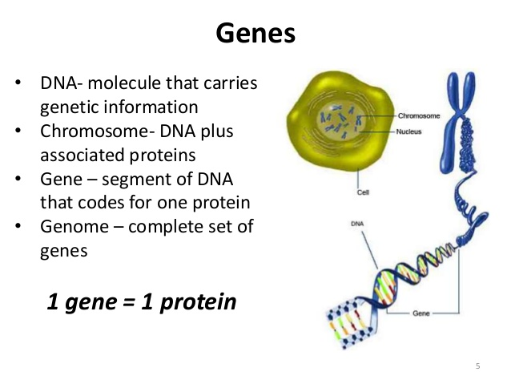

Slide 13
Premise I: The cell is like a human body & it can function without DNA
It is capable of respiration, digestion, reproduction & other life functions
The nucleus which contains genes is viewed as the control centre – the brain of the cell
If the nucleus is removed, the cell continues of perform all its life functions
Therefore the nucleus that it contains does not control the cell
The biology of belief: Bruce Lipton

Slide 14
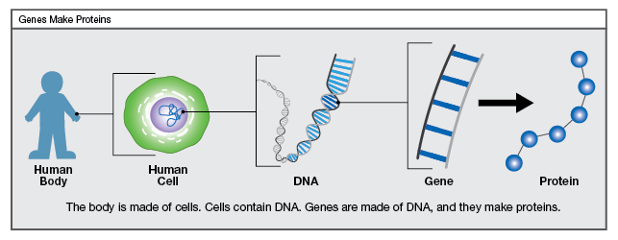
Premise II: DNA is controlled by the environment
Proteins carry out the functions of the cell & DNA determines the actions of proteins
Environmental stimuli that come in contact with cell membrane sets off a chain reaction of proteins
DNA is coated in a protective sleeve of protein, opens up with environmental signals, select specific genes for use & react in current situation
If there is no perception, DNA is inactive
The biology of belief: Bruce Lipton

Slide 15
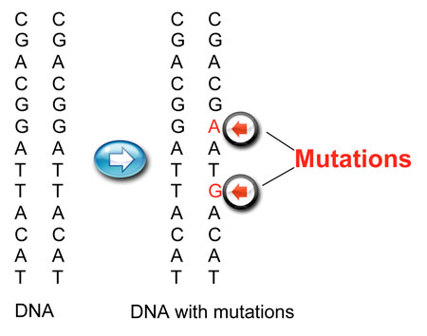
Premise III: Perception of environment is not necessarily the reality
Every cell has the gene whose function is to rewrite or adapt genes as necessary
Mutation in DNA is not random & happens in response of environmental signals in a specific order (The origin of Mutants: Nature- John Cairns, 1988)
Environmental signal is separate from organism’s perception of signals
Human perception acts as a filter in between
Perception rewrites genes
The biology of belief: Bruce Lipton

Slide 16
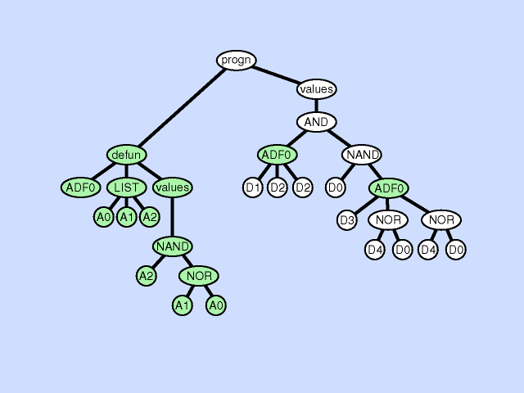
Premise IV: Human beliefs, choosing to perceive a positive or negative environment
Human senses are programmed in a way to determine which gene to be activated in a situation
Two classes of program : growth or protection
When a person gets love, growth genes are activated; protection genes are activated when encounters fear
Negative perception activate protection genes, triggering fight or flight response
The biology of belief: Bruce Lipton

Slide 17
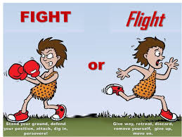
Premise V: Fight or Flight
When a person perceives negative environment, blood flows away from vital organ & is directed towards limbs, compromising immune system
Negative thoughts boost reflexes, at the cost of higher order mental functions
Beliefs act as a filter between real world & biology
So our choosing of beliefs determine what genes are to be expressed?
The biology of belief: Bruce Lipton

Slide 18
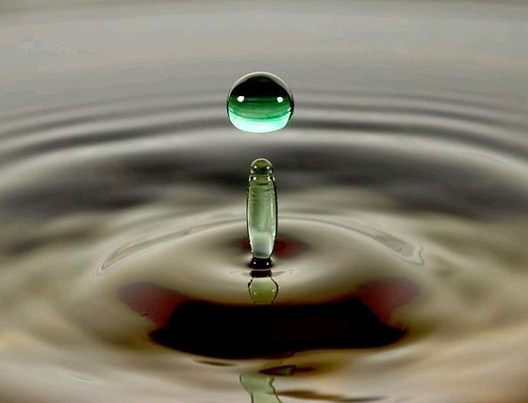
Thanks for believing…

